Slide 1

SCHOOL OF COMPUTING
DEPARTMENT OF COMPUTER SCIENCE & ENGINEERING
HACKATHON’20
“Sign language translation”
SUPERVISED BY
PRESENTED BY
1. Vishwajeet Chaurasia (VTU.NO 10422) (REG.NO 17UECN0067)
2. Ravi Kumar (VTU.NO 10593) (REG.NO 17UECS0644)
DR.THANGAMARIAPPAN
Associate Professor
Department of CSE
School of Computing

Slide 2
AGENDA . ABSTRACT . OBJECTIVE . INTRODUCTION . METHODOLOGIES . IMPLEMENTATION . Testing . INPUT AND OUTPUT . CONCLUSION . REFERENCES

Slide 3
ABSTRACT
A real-time sign language translator is an important milestone in facilitating communication between the deaf community and the general public. We hereby present the development and implementation of an American Sign Language (ASL) fingerspelling translator based on a convolutional neural network. We utilize a pre-trained Google Net architecture trained on the ILSVRC2012 dataset, as well as the Surrey University and Massey University ASL datasets in order to apply transfer learning to this task. We produced a robust model that consistently classifies letters a-e correctly with first-time users and another that correctly classifies letters a-k in a majority of cases. Given the limitations of the datasets and the encouraging results achieved, we are confident that with further research and more data, we can produce a fully generalizable translator for all ASL letters

Slide 4
OBJECTIVES
Aim of the Project:
The main objective is to translate sign language to text/speech. The framework provides a helping-hand for speech-impaired to communicate with the rest of the world using sign language
This leads to the elimination of the middle person who generally acts as a medium of translation
Scope of the Project:
Since deaf people are usually deprived of normal communication with other people, they have to rely on an interpreter or some visual communication. Now the interpreter can not be available always, so this project can help eliminate the dependency on the interpreter.
The system can be extended to incorporate the knowledge of facial expressions and body language too so that there is a complete understanding of the context and tone of the input speech.
A mobile and web based version of the application will increase the reach to more people.
Integrating hand gesture recognition system using computer vision for establishing 2-way communication system.

Slide 5
INTRODUCTION
American Sign Language (ASL) substantially facilitates communication in the deaf community. However, there are only ~250,000-500,000 speakers which significantly limits the number of people that they can easily communicate. The alternative of written communication is cumbersome, impersonal and even impractical when an emergency occurs. In order to diminish this obstacle and to enable dynamic communication, we present an ASL recognition system that uses Convolutional Neural Networks (CNN) in real time to translate a video of a user’s ASL signs into text. Our problem consists of three tasks to be done in real time:
1. Obtaining video of the user signing (input)
2. Classifying each frame in the video to a letter
3. Reconstructing and displaying the most likely word from classification scores (output)

Slide 6
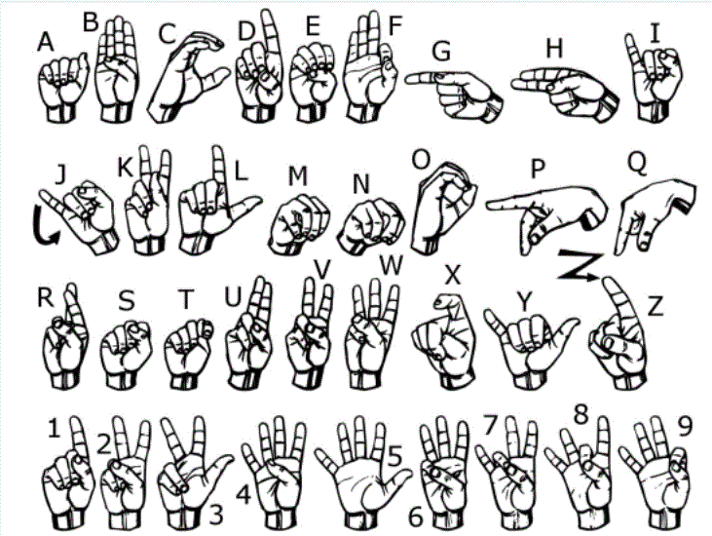
•Environmental concerns (e.G. Lighting sensitivity, background, and camera position) • Occlusion (e.G. Some or all fingers, or an entire hand can be out of the field of view) • Sign boundary detection (when a sign ends and the next begins) • Co-articulation (when a sign is affected by the preceding or succeeding sign)

Slide 7
METHOLOGIES
Our ASL letter classification is done using a convolutional neural network (CNN or ConvNet). CNNs are machine learning algorithms that have seen incredible success in handling a variety of tasks related to processing videos and images. Since 2012, the field has experienced an explosion of growth and applications in image classification, object localization, and object detection.
A primary advantage of utilizing such techniques stems from CNNs abilities to learn features as well as the weights corresponding to each feature. Like other machine learning algorithms, CNNs seek to optimize some objective function, specifically the loss function. We utilized a softmax-based loss function.
Using a softmax-based classification head allows us to output values akin to probabilities for each ASL letter. This differs from another popular choice: the SVM loss.
Using an SVM classification head would result in scores for each ASL letter that would not directly map to probabilities. These probabilities afforded to us by the softmax loss allow us to more intuitively interpret our results and prove useful when running our classifications through a language model.

Slide 8

IMPLEMENTATION
Architecture Diagram
Data –Flow Diagram

Slide 9
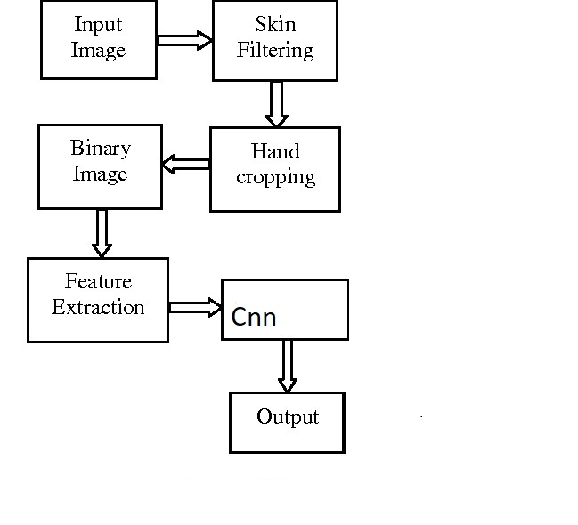
Architecture Diagram

Slide 10
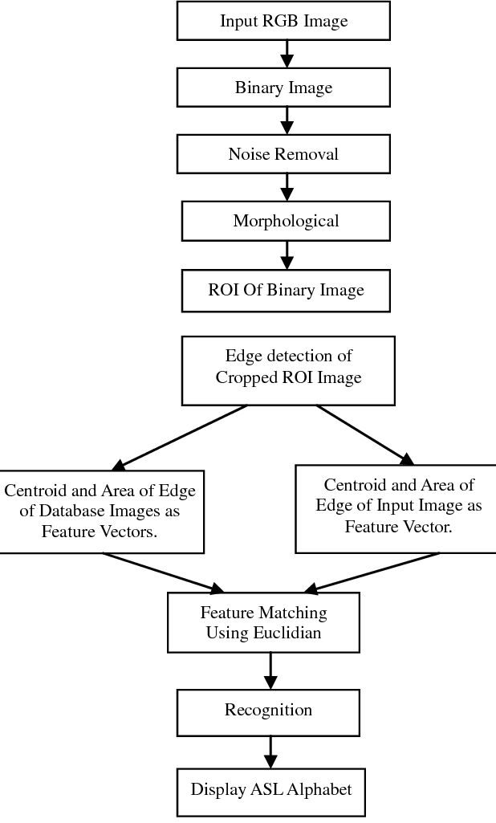
Data –Flow Diagram

Slide 11
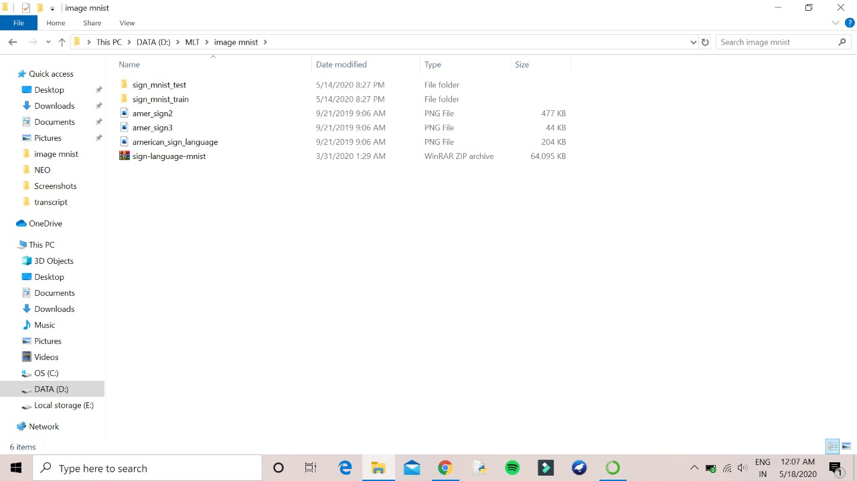
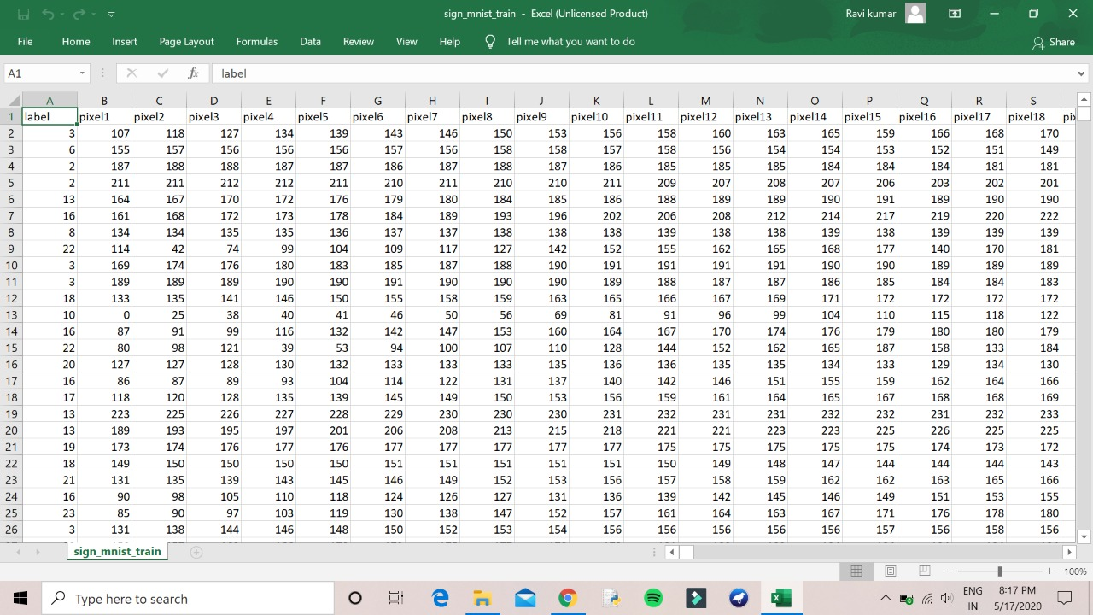
Testing
BATCH NO: 26 PRESENTED DATE: 18/05/2020

Slide 12
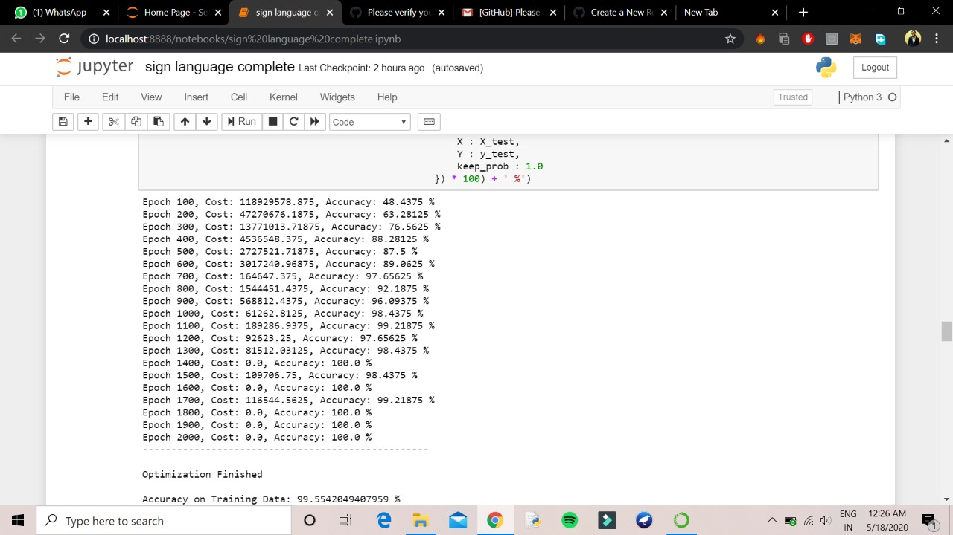
INPUT
BATCH NO: 26 PRESENTED DATE: 18/05/2020

Slide 13
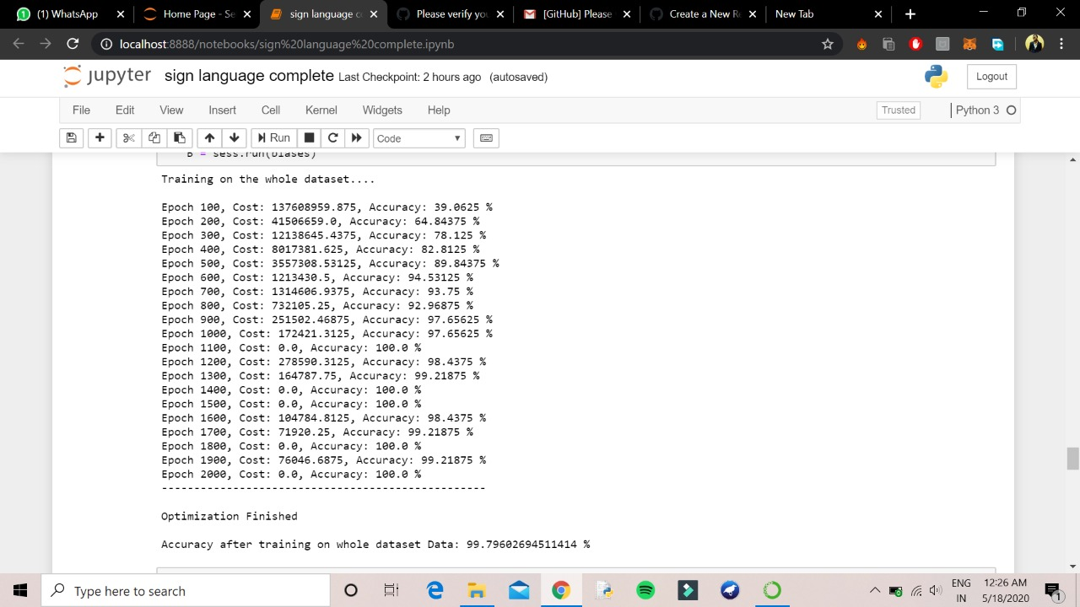

Slide 14
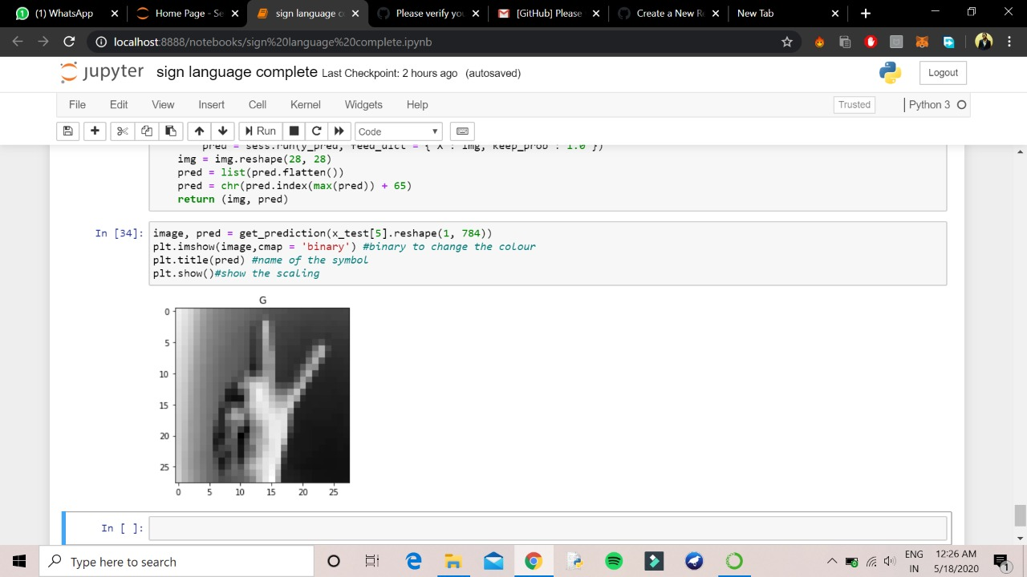
Output

Slide 15
Additional models: we focused our efforts on optimizing google net, but it would be worth exploring different nets that have also been proven effective at image classification .Image preprocessing: we believe that the classification task could be made much simpler if there is very heavy preprocessing done on the images. This would include contrast adjustment, background subtraction and potentially cropping. A more robust approach would be to use another CNN to localize and crop the hand. Language model enhancement: building a bigram and trigram language model would allow us to handle sentences instead of individual words. Along with this comes a need for better letter segmentation and a more seamless process for retrieving images from the user at a higher rate.
Future Work
BATCH NO: 26 PRESENTED DATE: 18/05/2020

Slide 16
Conclusion
Language translator on a web application based on a CNN classifier. We are able to produce a robust model for letters a-e, and a modest one for letters a-k .Because of the lack of variation in our datasets, the validation accuracies we observed during training were not directly reproducible upon testing on the web application. n. We hypothesize that with additional data taken in different environmental conditions, the models would be able to generalize with considerably higher efficacy and would produce a robust model for all letters
BATCH NO: 26 PRESENTED DATE: 18/05/2020

Slide 17
REFERENCES
[1] Mitchell, Ross; Young, Travas; Bachleda, Bellamie; Karchmer, Michael (2006). "How Many People Use ASL in the United States?: Why Estimates Need Updating" (PDF). Sign Language Studies (Gallaudet University Press.) 6 (3). ISSN 0302-1475. Retrieved November 27, 2012
D. Aryanie, Y. Heryadi. American Sign Language-Based Finger-spelling Recognition using k-Nearest Neighbors Classifier. 3rd International Conference on Information and Communication Technology (2015) 533-536
] R. Sharma et al. Recognition of Single Handed Sign Language Gestures using Contour Tracing descriptor. Proceedings of the World Congress on Engineering 2013 Vol. II, WCE 2013, July 3 - 5, 2013, London, U.K
T.Starner and A. Pentland. Real-Time American Sign Language Recognition from Video Using Hidden Markov Models. Computational Imaging and Vision, 9(1); 227-243, 1997.

Slide 18
THANK YOU

